Slide 1

Rust
Waterford Tech Meetup January 2025

Slide 2

What?
Photographer - David Bergin

Slide 3
Rust
fn main() {
println!("Hello, world");
}

Slide 4
Why?
Photographer - David Bergin

Slide 5
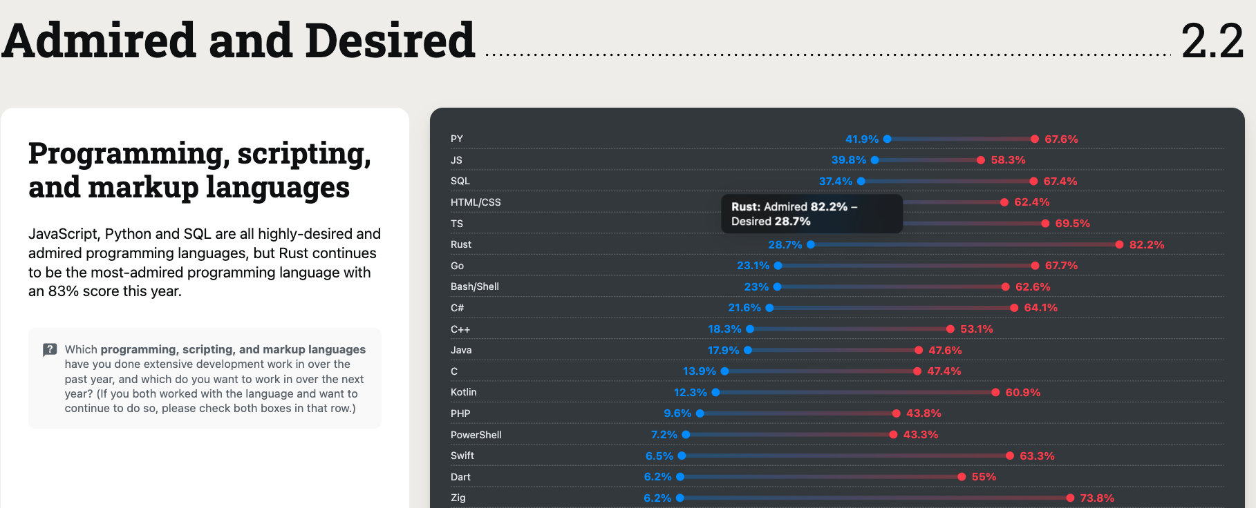

Slide 6
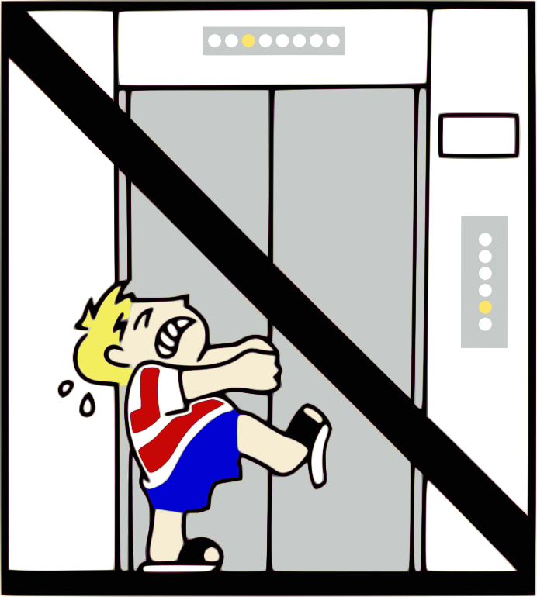


Alright so,… Where did it come from?
Notes:
In 2006,Graydon Hoare was a 29-year-old computer programmer working for Mozilla
Returning home to his apartment in Vancouver, he found that the elevator was out of order; its software had crashed.
This wasn’t the first time it had happened, either.

Slide 7
Walking to the 21st Floor Graydon Pondered…
I know what I’ll do, I’ll create a new programming language and name it Rust after a fungi that is overengineered for survival!!
It was probably another bug with memory management!
I wonder if the elevator code was written in C?
We computer people
couldn’t even make an elevator that works
without crashing

Slide 8

Rust was born as a…
A general purpose programming language built for performance, reliability and productivity.

Slide 9
Rust focuses on empowerment…
write high-performance, low-level code with guarantees of safety and reliability.
free devs to focus on building robust applications without worrying about common pitfalls like memory errors or race conditions

Slide 10
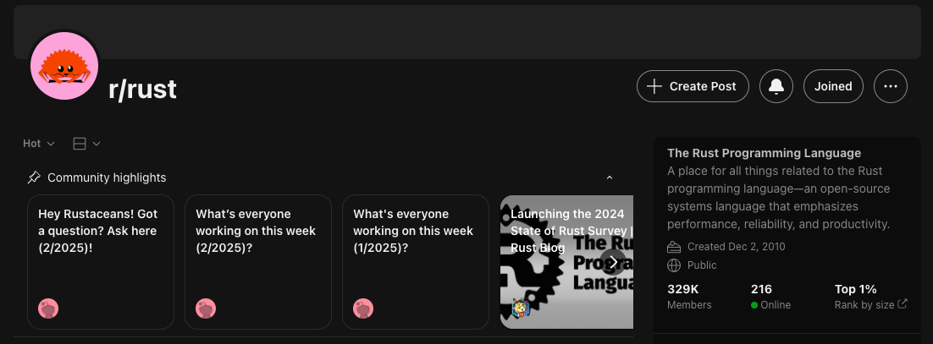
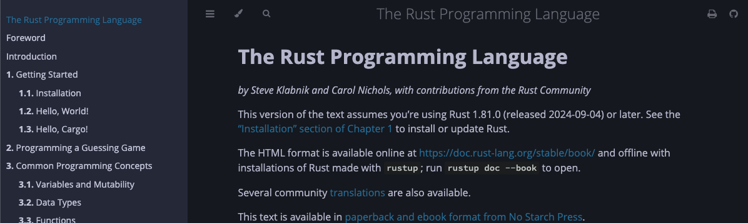
Empowerment?
Fearless Concurrency
Memory Safety
Modern Syntax
Cargo Package Manager
Interoperability
“Fearless” Refactoring
Documentation and Community

Slide 11
Rust is…
Typically referred to as a systems level programming language with an emphasis on memory safety

Slide 12
Systems Programming?
Low-level software that interacts closely with hardware, such as operating systems, drivers, networking stacks, and embedded systems.
Requires high performance, precise control over resources, and efficient memory management, making them critical for infrastructure and performance-sensitive applications.

Slide 13
Systems Programming?
Assembly
Used for hardware-level programming but lacks abstraction and portability.
C
Known for its low-level control and performance but prone to memory safety issues.
C++
Adds object-oriented features to C but retains similar risks of unsafe memory usage.
Go
Focused on simplicity and concurrency but lacks Rust's fine-grained control over memory.

Slide 14
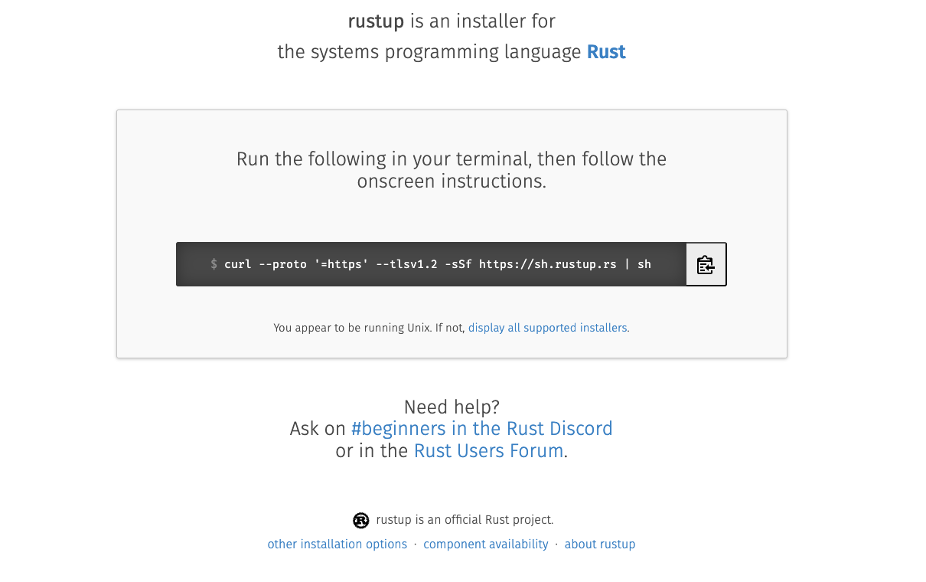
How do I rust…
rustup.rs

Slide 15
cargo new calc --lib

Slide 16

So….. Memory…..

Slide 17

We need to talk….
About the stack and the heap…
We got this!

Slide 18
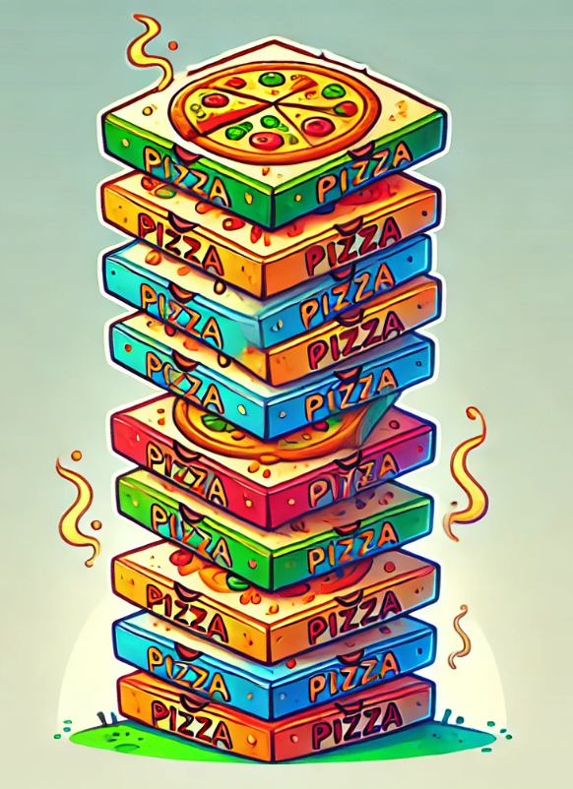
What is the stack and what is heap? – The stack
Both the stack and the heap are parts of memory available to your code to use at runtime, but they are structured in different ways
The stack stores known, fixed size data such as integers, booleans and characters
The stack is last in, first out, pushing to add and popping to remove
Working with the stack is very fast!

Slide 19
fn main() {
let first = 22;
let second = 33;
let sum = add(first, second);
println!("the sum of of {first} and {second} are {sum}");
}
fn add(a: i32, b: i32) -> i32 {
return a + b;
}
main()
first – i32 | 22
second – i32 | 33
sum – i32 | ?

Slide 20
add()
fn main() {
let first = 22;
let second = 33;
let sum = add(first, second);
println!("the sum of of {first} and {second} are {sum}");
}
fn add(a: i32, b: i32) -> i32 {
return a + b;
}
a – i32 | 22
b – i32 | 33
return address | 0x23f
main()
first – i32 | 22
second – i32 | 33
sum – i32 | ?

Slide 21
fn main() {
let first = 22;
let second = 33;
let sum = add(first, second);
println!("the sum of of {first} and {second} are {sum}");
}
fn add(a: i32, b: i32) -> i32 {
return a + b;
}
main()
first – i32 | 22
second – i32 | 33
sum – i32 | 55

Slide 22

The Heap
Think of the heap as a less organised “space” of data
Data with an unknown size at compile time or a size that might change must be stored on the heap.
A pointer to the data on the heap is stored on the stack

Slide 23
The Heap
Imagine you want to park a car of a certain size
You ask the attendant to allocate a space, store (park) your car
The attendant gives you a ticket that points to where your car is that you can use to retrieve your car
Or a pointer to retrieve the data

Slide 24
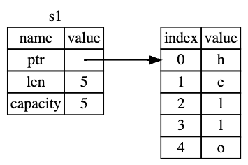
// a string could be retrieved from input
// so undefined size at compile time
let s1: String = String::from("hello");

Slide 25

What is memory safety on the stack?
#include <stdio.h>
int main(){
int initial_value = 60;
int items[5] = {1,2,3,4,5};
printf("initial value is %d\n", initial_value);
}

Slide 26
What is memory safety on the stack?
#include <stdio.h>
int main(){
int initial_value = 60;
int items[5] = {1,2,3,4,5};
printf("initial value is %d\n", initial_value);
}
Output: initial value is 60

Slide 27
What is memory safety on the stack?
#include <stdio.h>
int main(){
int initial_value = 60;
int items[5] = {1,2,3,4,5};
items[5] = 6; // put one too many in items
printf("initial value is %d\n", initial_value);
}

Slide 28
What is memory safety? (-fno-stack-protector)
#include <stdio.h>
int main(){
int initial_value = 60;
int items[5] = {1,2,3,4,5};
items[5] = 6; // put one too many in items
printf("initial value is %d\n", initial_value);
}
Output: initial value is 6, instead of 60 This all happens on the stack!

Slide 29
What is memory safety? (-fno-stack-protector)
To make this happen, we have to disable compile time protections
It is a simple example to illustrate how lower level languages can open doors to bugs

Slide 30
Dynamic memory allocation – The Heap
int main() {
// Dynamically allocate memory for an array of 10 integers
// This all happens on THE HEAP
int *ptr = (int *)malloc(10 * sizeof(int));
if (ptr == NULL) {
printf("Memory allocation failed\n");
return -1;
}
// Populate the allocated memory
for (int i = 0; i < 10; i++) {
ptr[i] = i;
printf ("%d", ptr[i]);
}
// Forget to free the allocated memory?
free(ptr); // <-- If this line is missing, causing a MEMORY LEAK
ptr = NULL; // if this line is missing, causes DANGLING POINTER
return 0;
}

Slide 31
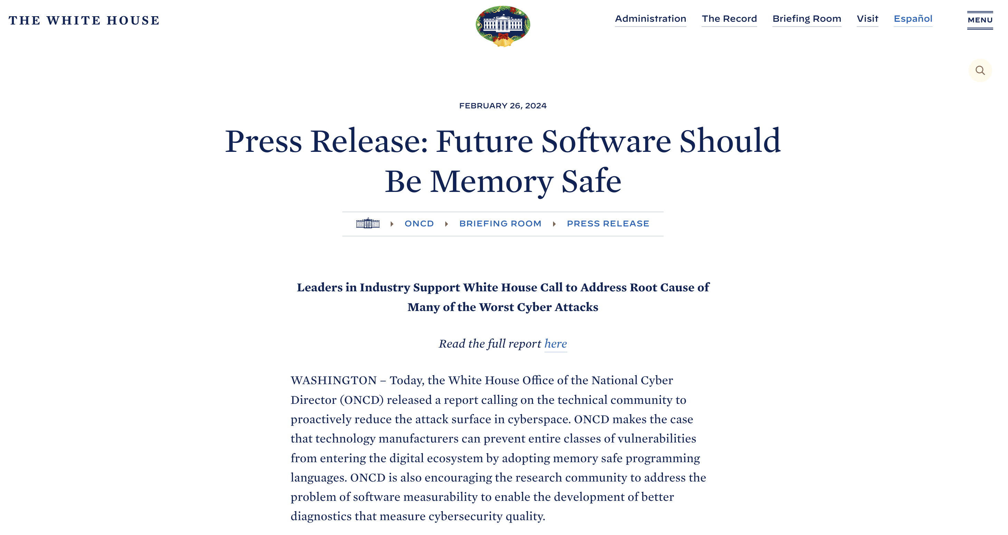
“Some of the most infamous cyber events in history – the Morris worm of 1988, the Slammer worm of 2003, the Heartbleed vulnerability in 2014, the Trident exploit of 2016, the Blastpass exploit of 2023 – were headline-grabbing cyberattacks that caused real-world damage to the systems that society relies on every day. Underlying all of them is a common root cause: memory safety vulnerabilities.”

Slide 32
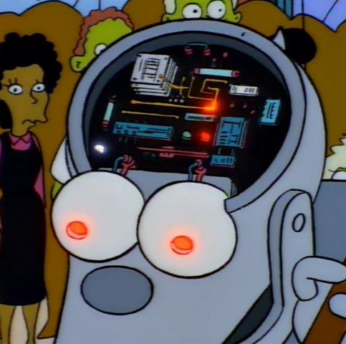
Focus on Memory Safety in Rust
Three Use Cases:
Memory Leaks
Dangling Pointers
Data Races

Slide 33

Come again?
Rust is a systems programming language
It was created with reliability and performance at it’s core
One of the main facets of this reliability is memory safety
We have 2 areas of memory where we are concerned
The Stack and the Heap
Dynamic allocation of memory can cause issues such as:
Memory leaks when forgetting to free memory
Dangling pointers when we forget to nullify pointers
Data Races: multiple pointers attempting to access data at once can cause “data races”
Even the White House is worried, so what makes Rust more memory safe?

Slide 34
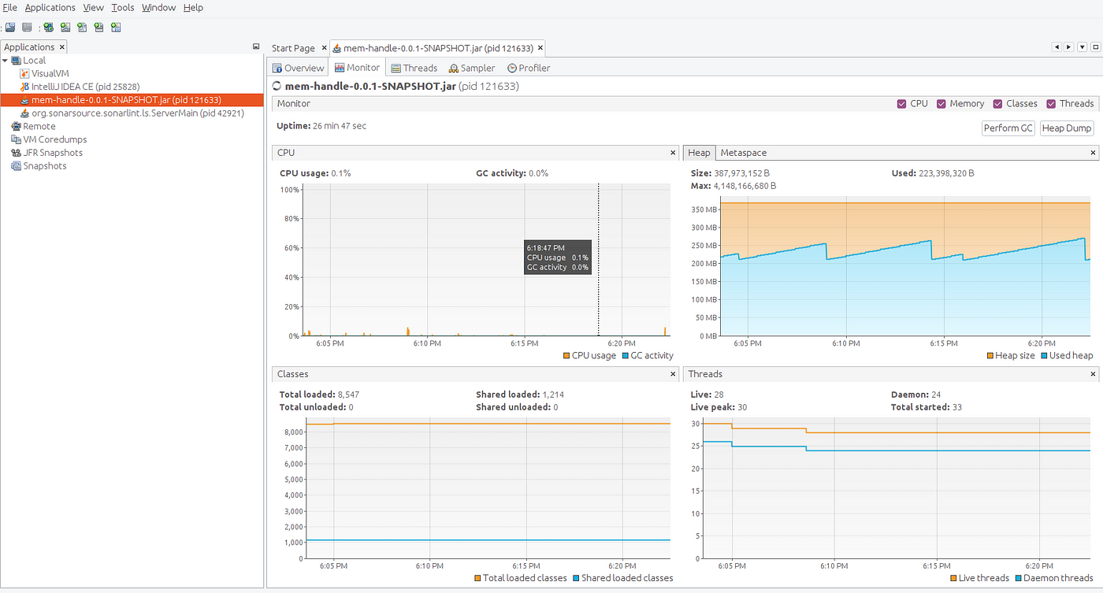
Well to improve performance, Rust does not use Garbage Collection to manage memory. (This is also to enable memory restricted use cases)

Slide 35

Rust has… Ownership!

Slide 36
What is Ownership?
JS Example that shows multiple owners…

Slide 37
Ownership is a set of rules that govern how a Rust program manages memory
Each value in Rust has an owner.
There can only be one owner at a time.
When the owner goes out of scope, the value will be dropped and memory freed
We will be introduced to the idea of MOVE and BORROW
fn main(){
let s1 = String::from("hello");
let s2 = s1;
println!("{s1}, world");
}

Slide 38
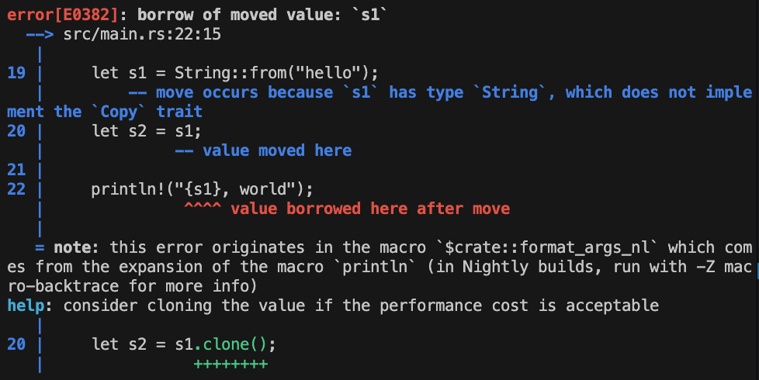
fn main(){
let s1 = String::from("hello");
let s2 = s1;
println!("{s1}, world");
}
This is compiler output!!!

Slide 39
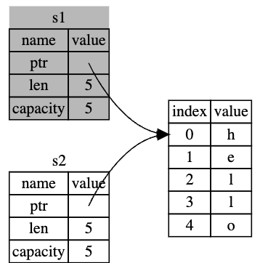
fn main(){
let s1 = String::from("hello");
let s2 = s1;
println!("{s1}, world");
}
S1 Invalidated
The compiler throws an error because we’ve moved OWNERSHIP from s1 to s2 and then attempted to us s1 after that.
Rust invalidates the first variable, it’s known as a MOVE.

Slide 40
fn main(){
let s1 = String::from("hello");
let s2 = s1;
println!("{s1}, world");
}
S1 Invalidated
This is the a rule of ownership, a value on the heap can only have one owner
This prevents us creating multiple references to objects on the heap, thus reducing the possibility of a MEMORY LEAK

Slide 41

This gets even weirder with functions
Well, weird, from a certain point of view

Slide 42
fn main() {
let s1 = String::from("hello");
let len = calculate_length(s1);
// will get same error here println!("The length of '{s1}' is {len}.");
}
fn calculate_length(s: String) -> usize {
s.len()
}

Slide 43
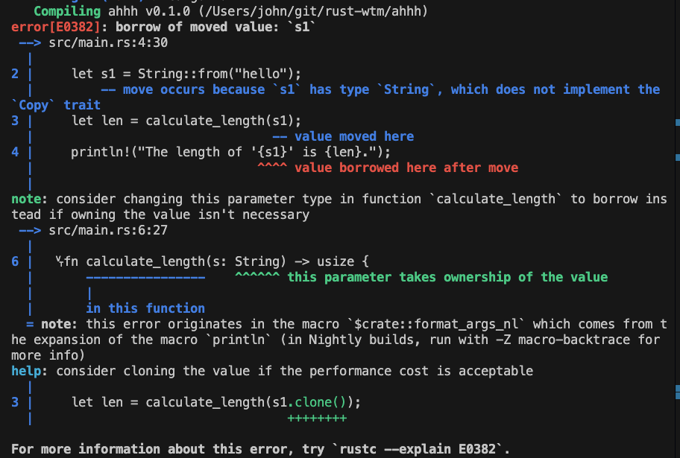
fn main() {
let s1 = String::from("hello");
let len = calculate_length(s1);
// will get same error here println!("The length of '{s1}' is {len}.");
}
fn calculate_length(s: String) -> usize {
s.len()
}
Again, this is compiler output

Slide 44
fn main() {
let s1 = String::from("hello");
let len = calculate_length(s1);
// will get same error here println!("The length of '{s1}' is {len}.");
}
fn calculate_length(s: String) -> usize {
s.len()
}
We are transferring OWNERSHIP of “s1” from main to the function we are calling When that function ends, ”s” is DROPPED as it’s new owner is no longer in scope, even though it is still in scope in main.

Slide 45

So, we can’t pass a variable to a function and use it afterwards?

Slide 46

References and Borrowing
We must create a REFERENCE and pass that to our function
And use this REFERENCE to BORROW
We can create a reference using &

Slide 47
fn main() {
let s1 = String::from("hello");
let len = calculate_length(s1);
// will get same error here println!("The length of '{s1}' is {len}.");
}
fn calculate_length(s: String) -> usize {
s.len()
}
Passing a reference does not change ownership
fn main() {
let s1 = String::from("hello");
let len = calculate_length(&s1);// & HERE!
println!("The length of '{s1}' is {len}.");
}
fn calculate_length(s: &String) -> usize { // & HERE!
s.len() // rust automatically dereferences
}

Slide 48
fn main() {
let s1 = String::from("hello");
let len = calculate_length(&s1);// & HERE!
println!("The length of '{s1}' is {len}.");
}
fn calculate_length(s: &String) -> usize { // & HERE!
s.len() // rust automatically dereferences
}
We call the action of creating a reference and passing it around - BORROWING
We cannot edit what we have borrowed, well we can but not without making changes, but first….

Slide 49
Recap
Rust enforces a single owner on data stored in the heap
Reassigning, s2=s1, will MOVE and change ownership, invalidating the original owner
This ensures we have no dangling REFERENCES causing MEMORY LEAKS
The Rust compiler impressively protects both the stack and the heap
We can use REFERENCES to BORROW a value in another function
However, these REFERENCES are IMMUTABLE!

Slide 50

In Rust, everything is immutable by default
Immutability
Why don’t you just marry immutability?

Slide 51

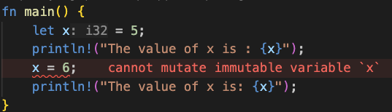
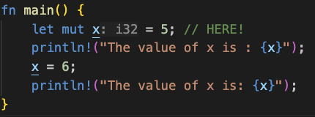
Immutability
Rust enforces immutability by default, that is, you cannot change, for example, the value of a variable
We need to intentionally define a variable as mutable, that is, we can change the value of the variable

Slide 52
Mutable References
References are immutable by default, so the following would throw a compile error
fn main() {
let mut s = String::from("hello");
change(&s);
}
fn change(some_string: &String) {
some_string.push_str(", world");
}

Slide 53
Mutable References
To allow editing of our value via reference, we can use mutable references
fn main() {
let mut s = String::from("hello");
change(&s);
}
fn change(some_string: &String) {
some_string.push_str(", world");
}
fn main() {
let mut s = String::from("hello");
change(&mut s);
}
fn change(some_string: &mut String) {
some_string.push_str(", world");
}

Slide 54
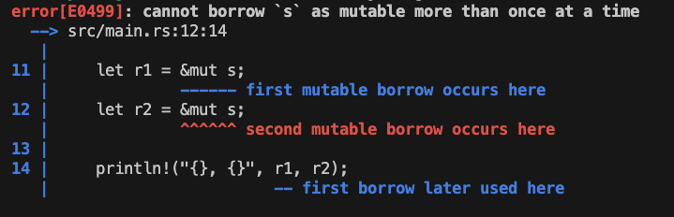
Mutable References
BUT, we cannot have more than 2 simultaneous mutable references AND the compiler enforces this:
fn main() {
let mut s = String::from("hello");
let r1 = &mut s;
let r2 = &mut s;
println!("{}, {}", r1, r2);
}

Slide 55
Mutable References
Disallowing multiple simultaneous references solves our last (for today…) memory safety concern, data races
A data race is similar to a race condition and happens when these three behaviours occur:
Two or more pointers access the same data at the same time.
At least one of the pointers is being used to write to the data.
There’s no mechanism being used to synchronize access to the data.
Data races cause undefined behaviour and can be difficult to diagnose and fix when you’re trying to track them down at runtime

Slide 56
Recap
We’ve seen how the rust compiler can
Prevent numerous memory safety concerns at compile time
Even when dealing with dynamically allocated memory in the heap
That was a slog, some easy slides

Slide 57
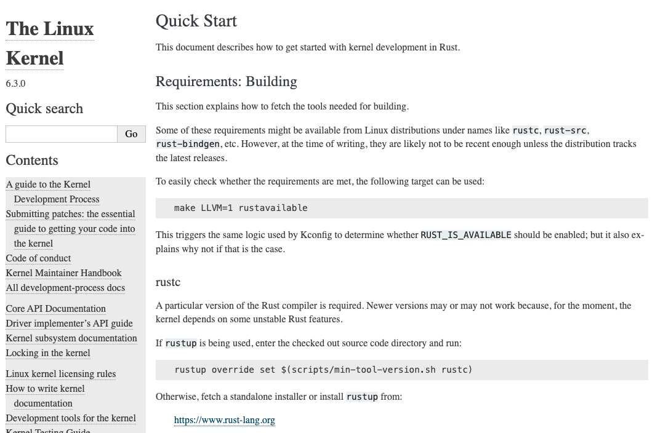
Who is using rust? The Linux Kernal

Slide 58

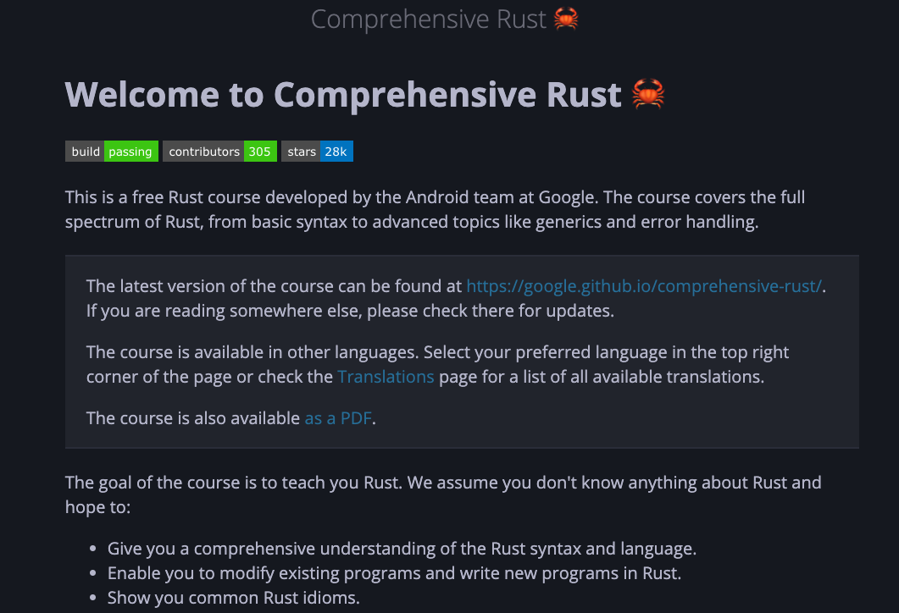

Who is using rust? Google
At Google, we have been seeing increased Rust adoption, especially in our consumer applications and platforms
https://google.github.io/comprehensive-rust/

Slide 59
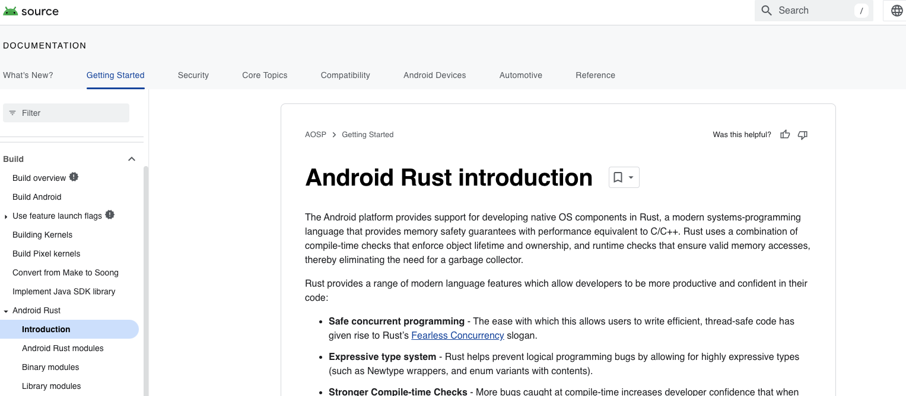
Who is using rust? Android
The transition to memory-safe languages such as Rust as part of its secure-by-design approach has led to the percentage of memory-safe vulnerabilities discovered in Android dropping from 76% to 24% over a period of six years.

Slide 60
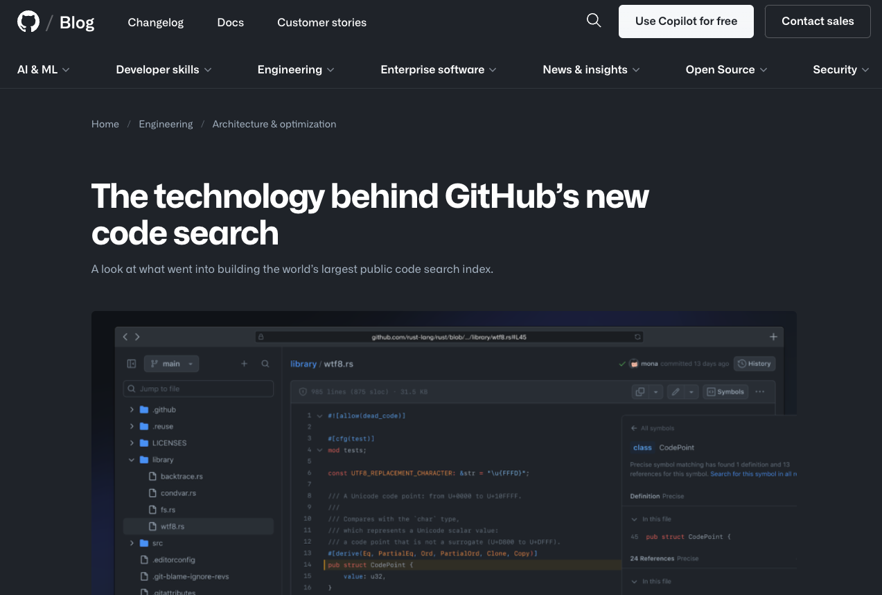
Who is using rust? GitHub

Slide 61



Who is using rust? AWS

Slide 62
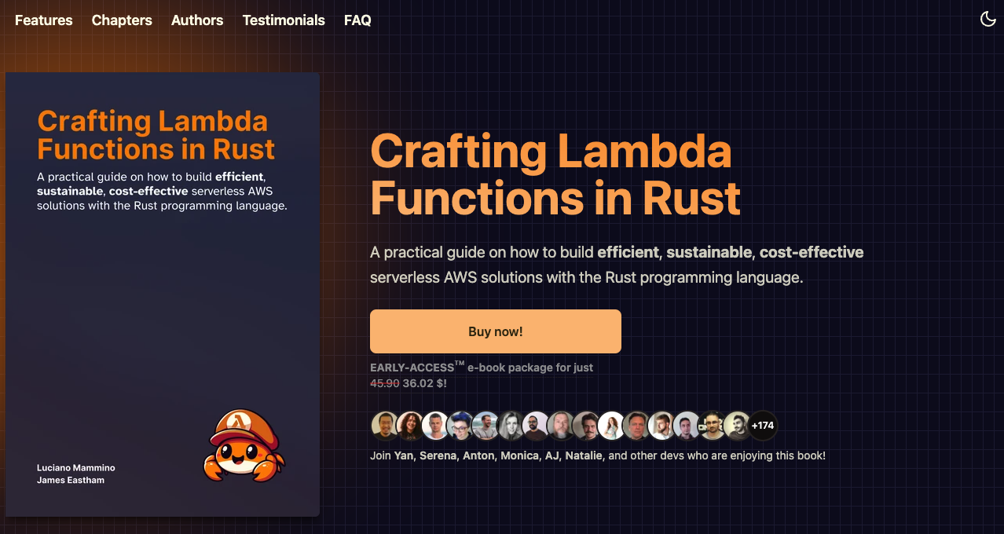
Who is using rust? YOU, in lambda ;)
https://rust-lambda.com/

Slide 63
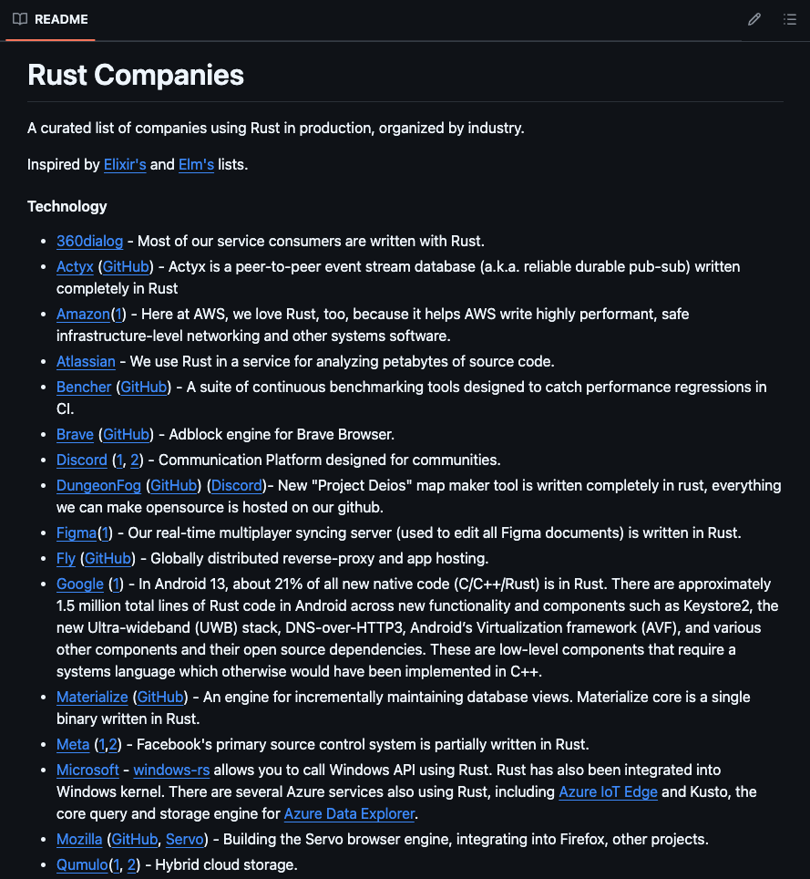
Who is using rust? More
https://github.com/omarabid/rust-companies

Slide 64

Snake…. You should have used Rust!

Slide 65
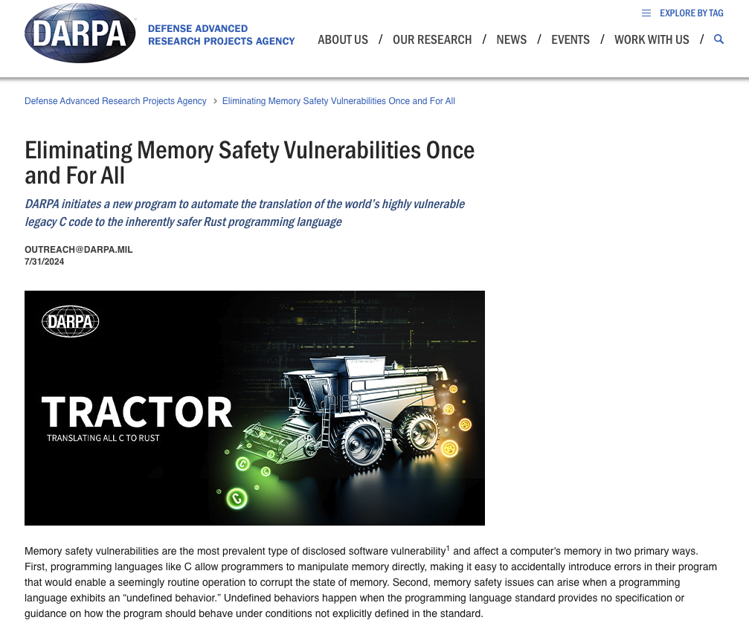
DARPA on Rust https://www.darpa.mil/news-events/2024-07-31a

Slide 66
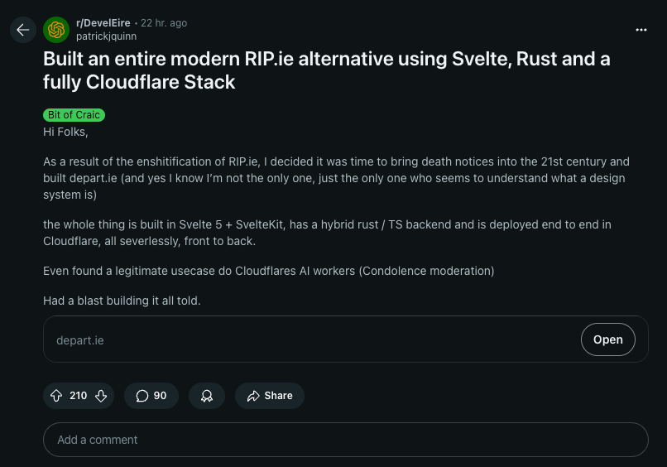

Slide 67

Questions? (or beer?)

